Slide 1
Academic year 2020-2021
3rd year S 5/6
CPT Module
Session 6 Lecture 2
Pharmacology of Airway Control
Lecturer : Dr. Ali Taleb Abdulsamad
Module staff:
Prof. Dr. Mazin Hawaz
Dr. Majid Hameed Dr. Faleh Waheed
Dr. Sarah Mohamed Dr. Raghdah Al Wiswasy
Dr. Rehab Abdul wahab Dr. Mohammed Adel
Dr. Haitham Khadum Dr. Eatidal Farhan
Dr. Ahmed Jaffer Dr. Miami Kadhum
Module Leader: Dr. Hussain Alyahyaoy
Golan et al: Principles of Pharmacology: The Pathophysiologic Basis of Drug Therapy. Third Edition. Lippincott Williams and Wilkin
For more discussion, questions or cases need help please post to the session group

Slide 2
UNIVERSITY OF BASRAH AL-ZAHRAA MEDICAL COLLEGE
Ministry of Higher Education and Scientific Researches
Learning objectives:
Have reviewed relevant previous module material on Respiration and Asthma
Understand autonomic innervation pharmacology of bronchial smooth muscle
Be able to describe the main features underlying pathophysiology of asthma including that responsible for early and late phase response
Know in detail the action of different bronchodilators and when they are used, namely: short and long acting β2-agonists; methylxanthines; muscarinic receptor antagonists
Understand the broad mechanism of anti-inflammatory action of the corticosteroids
Be able to outline the general steps in management of asthma
Describe the steps in management of severe acute asthma
Have made brief notes on COPD

Slide 3
UNIVERSITY OF BASRAH AL-ZAHRAA MEDICAL COLLEGE
Ministry of Higher Education and Scientific Researches
Asthma and COPD LO1
Asthma is the commonest childhood disease with increasing prevalence in adults.
A chronic inflammatory disorder that leads to airway obstruction characterised by bronchoconstriction and mucus plugging
Can lead to life threatening hypoxaemia if not treated.
Asthma is reversible while COPD is not fully reversible.
Bronchoconstriction leads to increased lower airway resistance.
40-50% of flow resistance is in the upper respiratory tract.

Slide 4
UNIVERSITY OF BASRAH AL-ZAHRAA MEDICAL COLLEGE
Ministry of Higher Education and Scientific Researches
Autonomic modulation of Airway Resistance LO2
Notes:
The physiolol role of beta-adrenergic receptors is unclear and their function seems normal in asthmatic patients. Inhibitory nonadrenergic noncholinergic (NANC) nerves, containing vasoactive intestinal peptide and nitric oxide, may be the only neural bronchodilator pathways in human airways. Although a dysfunction of inhibitory NANC nerves has been proposed in asthma, thus far no differences in inhibitory NANC responses have been found between asthmatics and healthy subjects. Excitatory NANC nerves, extensively studied in animal airways, have also been detected in human airways. In animal studies, stimulation of excitatory NANC nerves causes bronchoconstriction, mucus secretion, vascular hyperpermeability, cough, and vasodilation, a process called 'neurogenic inflammation'. Recent studies have demonstrated an interaction between the excitatory NANC nervous system and inflammatory cells. Neuropeptides may influence the recruitment, proliferation, and activation of leukocytes. gicaOn the other hand, inflammatory cells may modulate the neuronal phenotype and function. The functional relevance of the excitatory NANC nervous system and its interaction with the immune system in asthma still remains to be elucidated.

Slide 5
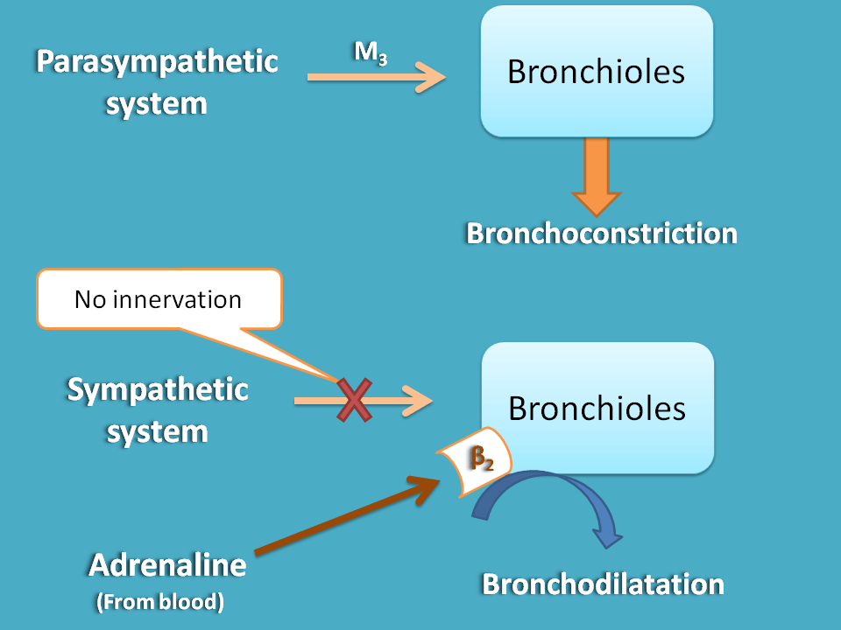
UNIVERSITY OF BASRAH AL-ZAHRAA MEDICAL COLLEGE
Ministry of Higher Education and Scientific Researches
Autonomic modulation of Airway Resistance LO2

Slide 6
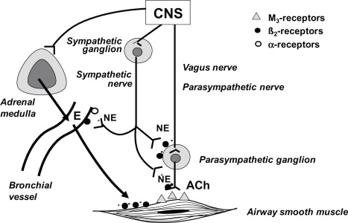
UNIVERSITY OF BASRAH AL-ZAHRAA MEDICAL COLLEGE
Ministry of Higher Education and Scientific Researches
Autonomic modulation of Airway Resistance LO2

Slide 7
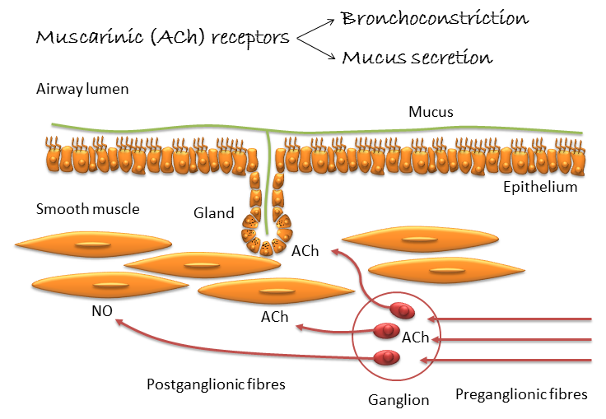
UNIVERSITY OF BASRAH AL-ZAHRAA MEDICAL COLLEGE
Ministry of Higher Education and Scientific Researches
Autonomic modulation of Airway Resistance LO2

Slide 8
UNIVERSITY OF BASRAH AL-ZAHRAA MEDICAL COLLEGE
Ministry of Higher Education and Scientific Researches
Pathophysiology of Asthma LO3
Antigen
immediate
late
20 min
Type 1 hypersensitivity
Allergen + IgE
Mast cell degranulation
bronchoconstiction
3 – 12 hours
Type VI hypersensitivity
eosinophils, mast cells, lymphocytes, & neutrophils
airway inflammation

Slide 9
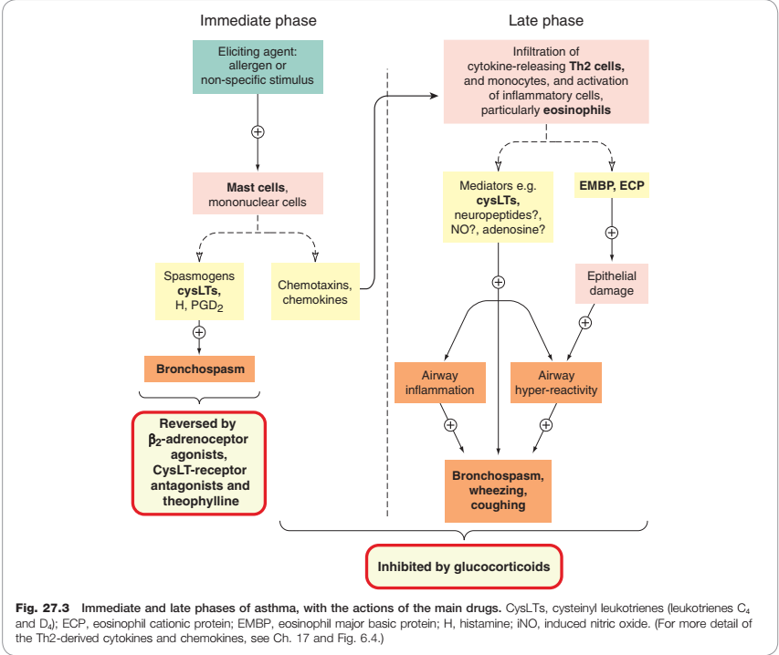
UNIVERSITY OF BASRAH AL-ZAHRAA MEDICAL COLLEGE
Ministry of Higher Education and Scientific Researches

Slide 10
UNIVERSITY OF BASRAH AL-ZAHRAA MEDICAL COLLEGE
Ministry of Higher Education and Scientific Researches
Pathophysiology of Asthma LO3
Bronchial hyperresponsiveness: an exaggerated bronchoconstrictor response to direct pharmacological stimuli such as histamine, or indirect stimuli such as exercise
A key factor contributing to airway dysfunction in asthma
The indirect stimuli activate mast cell mediators (induce the bronchoconstriction)

Slide 11
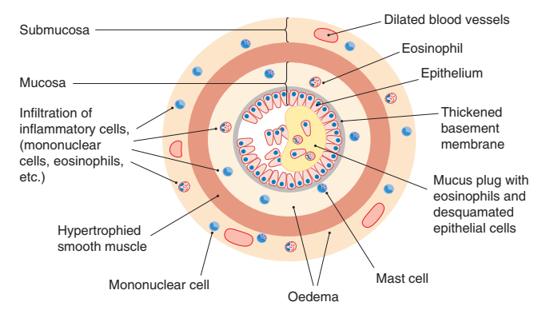
UNIVERSITY OF BASRAH AL-ZAHRAA MEDICAL COLLEGE
Ministry of Higher Education and Scientific Researches
Schematic diagram of a cross section of a bronchiole, showing changes that occur with severe chronic asthma.

Slide 12
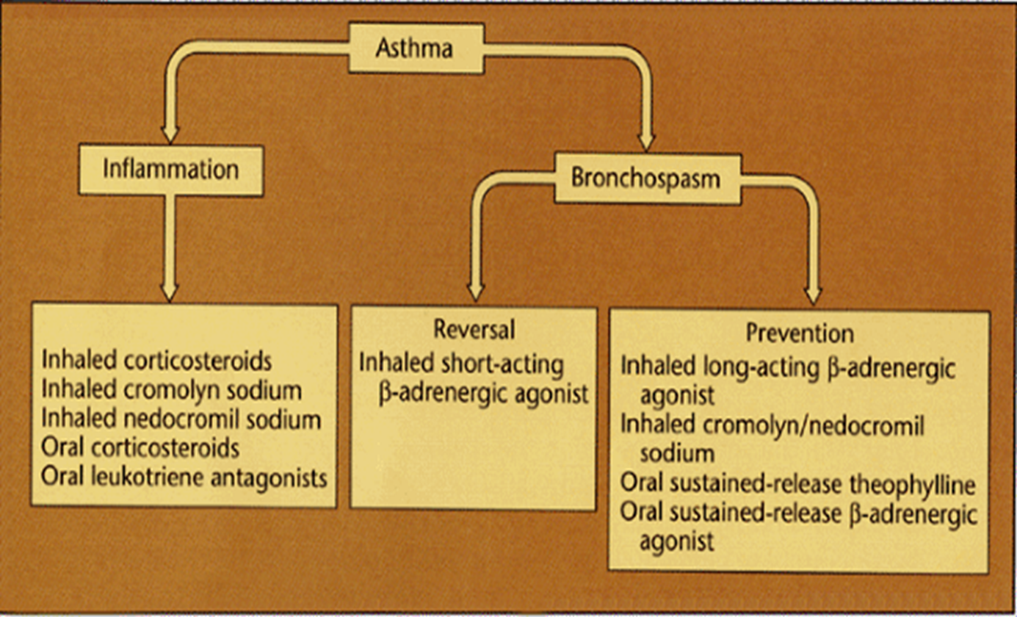
UNIVERSITY OF BASRAH AL-ZAHRAA MEDICAL COLLEGE
Ministry of Higher Education and Scientific Researches
Asthma Therapeutics: General Pharmacology LO4

Slide 13
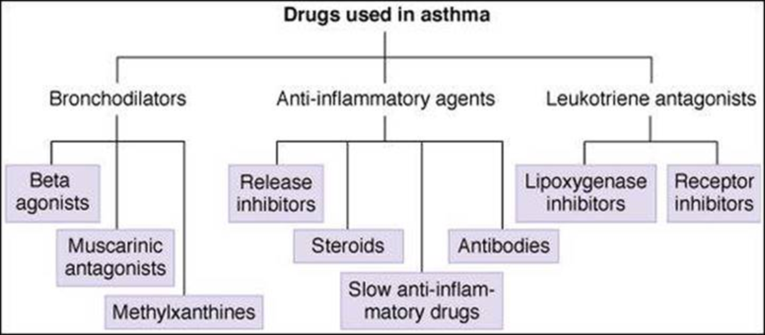
UNIVERSITY OF BASRAH AL-ZAHRAA MEDICAL COLLEGE
Ministry of Higher Education and Scientific Researches
Asthma Therapeutics: General Pharmacology LO4

Slide 14
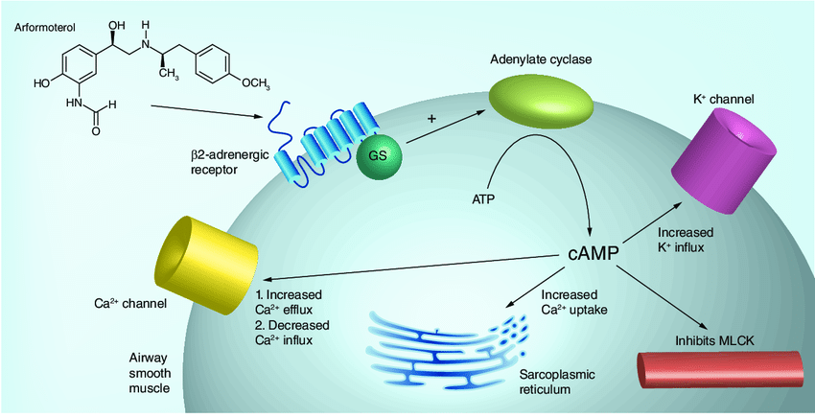
UNIVERSITY OF BASRAH AL-ZAHRAA MEDICAL COLLEGE
Ministry of Higher Education and Scientific Researches
Bronchodilators (relievers) β2-Agonists LO4

Slide 15
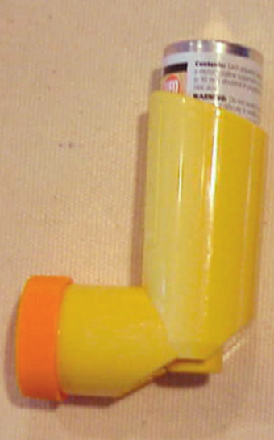
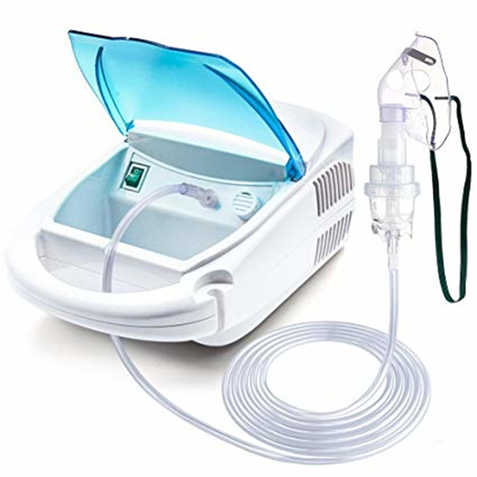
UNIVERSITY OF BASRAH AL-ZAHRAA MEDICAL COLLEGE
Ministry of Higher Education and Scientific Researches
Bronchodilators (relievers) β2-Agonists LO4
metered-dose inhaler dry powder inhaler nebulizer iv solution

Slide 16
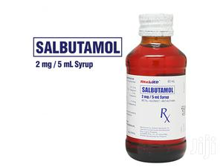
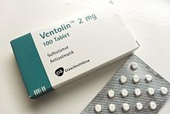
UNIVERSITY OF BASRAH AL-ZAHRAA MEDICAL COLLEGE
Ministry of Higher Education and Scientific Researches
Bronchodilators (relievers) β2-Agonists LO4
Tablets syrup

Slide 17
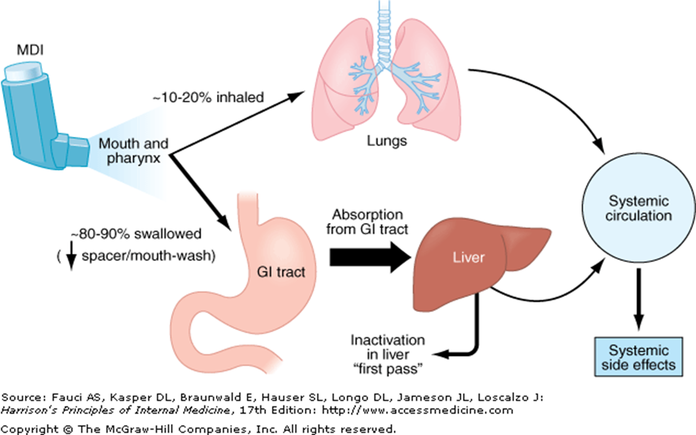
UNIVERSITY OF BASRAH AL-ZAHRAA MEDICAL COLLEGE
Ministry of Higher Education and Scientific Researches
Bronchodilators (relievers) β2-Agonists LO4

Slide 18
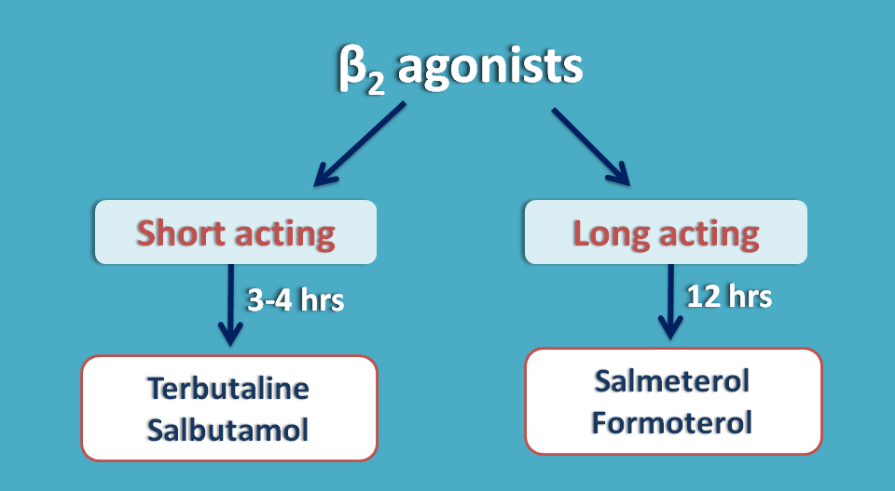
UNIVERSITY OF BASRAH AL-ZAHRAA MEDICAL COLLEGE
Ministry of Higher Education and Scientific Researches
Bronchodilators (relievers) β2-Agonists LO4

Slide 19
UNIVERSITY OF BASRAH AL-ZAHRAA MEDICAL COLLEGE
Ministry of Higher Education and Scientific Researches
Bronchodilators (relievers) β2-Agonists LO4
Given in adjunct with anti-inflammatories, where corticosteroid therapy does not provide adequate control of asthma.
Indicated for treatment of nocturnal asthma (a marker of poor asthma control).

Slide 20
UNIVERSITY OF BASRAH AL-ZAHRAA MEDICAL COLLEGE
Ministry of Higher Education and Scientific Researches
Bronchodilators (relievers) β2-Agonists LO4
ADRs/Drug Interactions:
skeletal muscle tremor (inhaled high doses).
tachycardia and dysrhythmia (despite they are very selective = 200-400 times β1).
negative interaction is with β-blockers such as propanolol (binds to both β1 and β2 receptors). This can lead to severe asthma refractive to any treatment with β2-agonists.

Slide 21
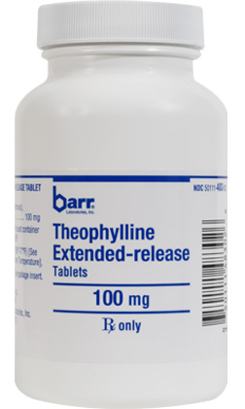
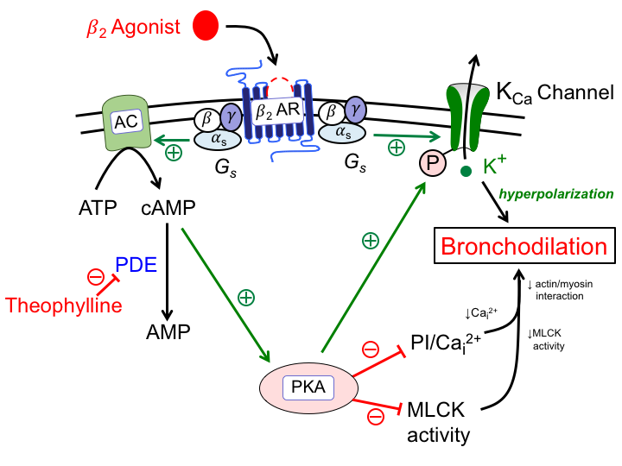
UNIVERSITY OF BASRAH AL-ZAHRAA MEDICAL COLLEGE
Ministry of Higher Education and Scientific Researches
Bronchodilators (relievers) Methylxanthines LO4

Slide 22
UNIVERSITY OF BASRAH AL-ZAHRAA MEDICAL COLLEGE
Ministry of Higher Education and Scientific Researches
Bronchodilators (relievers) Methylxanthines LO4
ADRs:
mediated via adenosine receptor antagonism
narrow therapeutic window (plasma levels ~ 30-100 uM)
psychomotor agitation
tachycardia
** Theophylline is used in COPD and status asthmaticus.

Slide 23
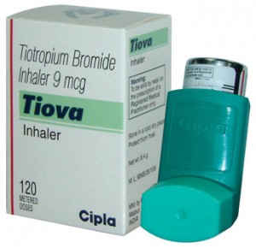
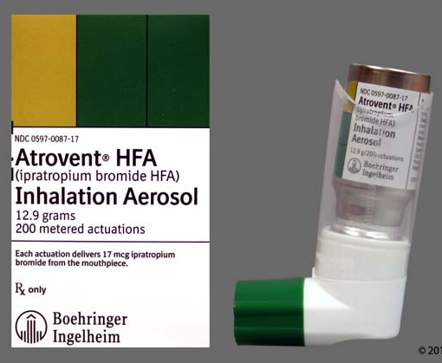
UNIVERSITY OF BASRAH AL-ZAHRAA MEDICAL COLLEGE
Ministry of Higher Education and Scientific Researches
Bronchodilators (relievers) Anticholinergics: Muscarinic Receptor Antagonists LO4

Slide 24
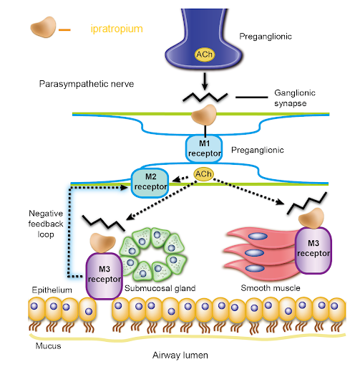
UNIVERSITY OF BASRAH AL-ZAHRAA MEDICAL COLLEGE
Ministry of Higher Education and Scientific Researches
Bronchodilators (relievers) Anticholinergics: Muscarinic Receptor Antagonists LO4

Slide 25
UNIVERSITY OF BASRAH AL-ZAHRAA MEDICAL COLLEGE
Ministry of Higher Education and Scientific Researches
Bronchodilators (relievers) Anticholinergics: Muscarinic Receptor Antagonists LO4
Not in first line use for asthma
Augment the action of β2- agonists
Indicated in those unresponsive to β2-agonists during acute exacerbations
In patients where β2-agonist use is contra-indicated
In treating COPD

Slide 26
UNIVERSITY OF BASRAH AL-ZAHRAA MEDICAL COLLEGE
Ministry of Higher Education and Scientific Researches

Slide 27
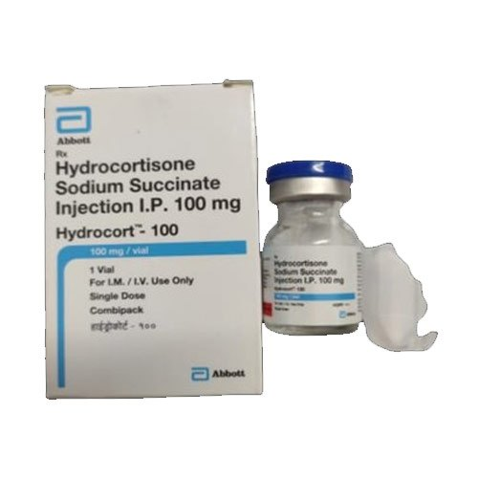
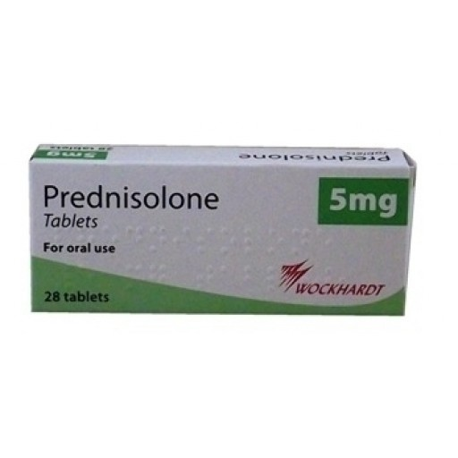
UNIVERSITY OF BASRAH AL-ZAHRAA MEDICAL COLLEGE
Ministry of Higher Education and Scientific Researches
Anti-inflammatories – Corticosteroids LO5

Slide 28
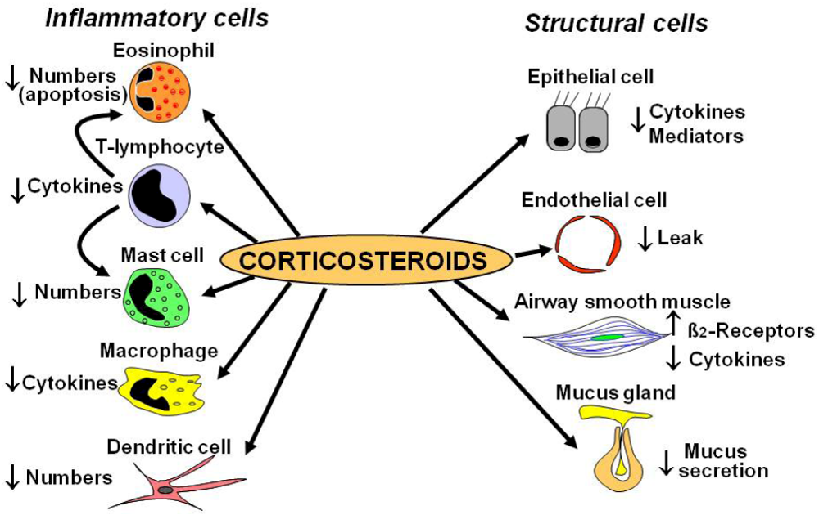
UNIVERSITY OF BASRAH AL-ZAHRAA MEDICAL COLLEGE
Ministry of Higher Education and Scientific Researches
Anti-inflammatories – Corticosteroids LO5

Slide 29
UNIVERSITY OF BASRAH AL-ZAHRAA MEDICAL COLLEGE
Ministry of Higher Education and Scientific Researches
Anti-inflammatories – Corticosteroids LO5

Slide 30
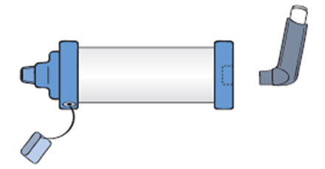
UNIVERSITY OF BASRAH AL-ZAHRAA MEDICAL COLLEGE
Ministry of Higher Education and Scientific Researches
Anti-inflammatories – Corticosteroids LO5
Spacer devise

Slide 31
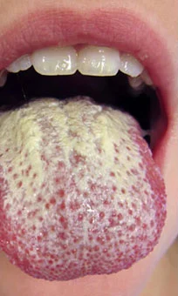
UNIVERSITY OF BASRAH AL-ZAHRAA MEDICAL COLLEGE
Ministry of Higher Education and Scientific Researches
Anti-inflammatories – Corticosteroids LO5
Acute asthma exacerbation: 40 mg prednisolone for 1-2 weeks.
Severe asthma: intravenous hydrocortisone
ADRs;
croaky voice
sore throat
Thrush
Systemic SE
** newer drugs, e.g. fluticasone and budesonide have poor systemic absorption and heavily metabolized with a spacer (lower SE)

Slide 32
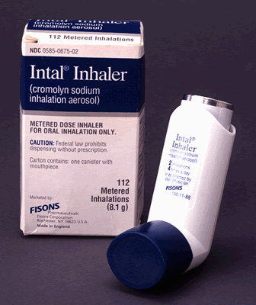
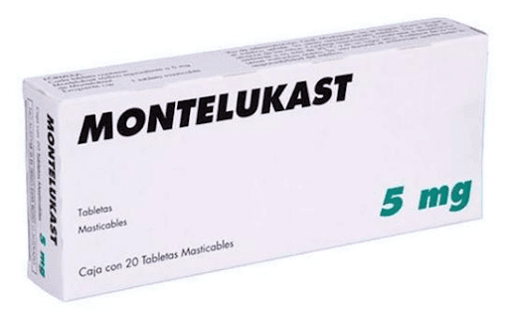
UNIVERSITY OF BASRAH AL-ZAHRAA MEDICAL COLLEGE
Ministry of Higher Education and Scientific Researches
Asthma Therapeutics: Other therapeutics LO5
Cromoglycate:
Mast cell stabilizer
Exercise induced asthma (10 min before exercise)
Asthma (2-4 times/day)
t1/2 = 90 min
Duration = 6 hr.
Leukotrienes Receptor Antagonists:
t1/2 = 3-6 hr
Metabolised by the liver
Once daily
ADR: headache.

Slide 33
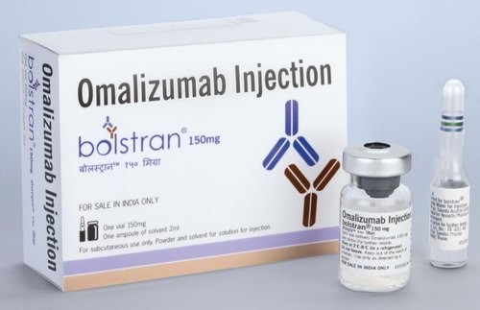
UNIVERSITY OF BASRAH AL-ZAHRAA MEDICAL COLLEGE
Ministry of Higher Education and Scientific Researches
Asthma Therapeutics: Other therapeutics LO5
Anti- IgE:
Given every 2-4 weeks.
SC
IgE monitored before and during
Therapy
ADR: injection site reaction and
URTI
t1/2 = 26 days
Excreted in bile.

Slide 34
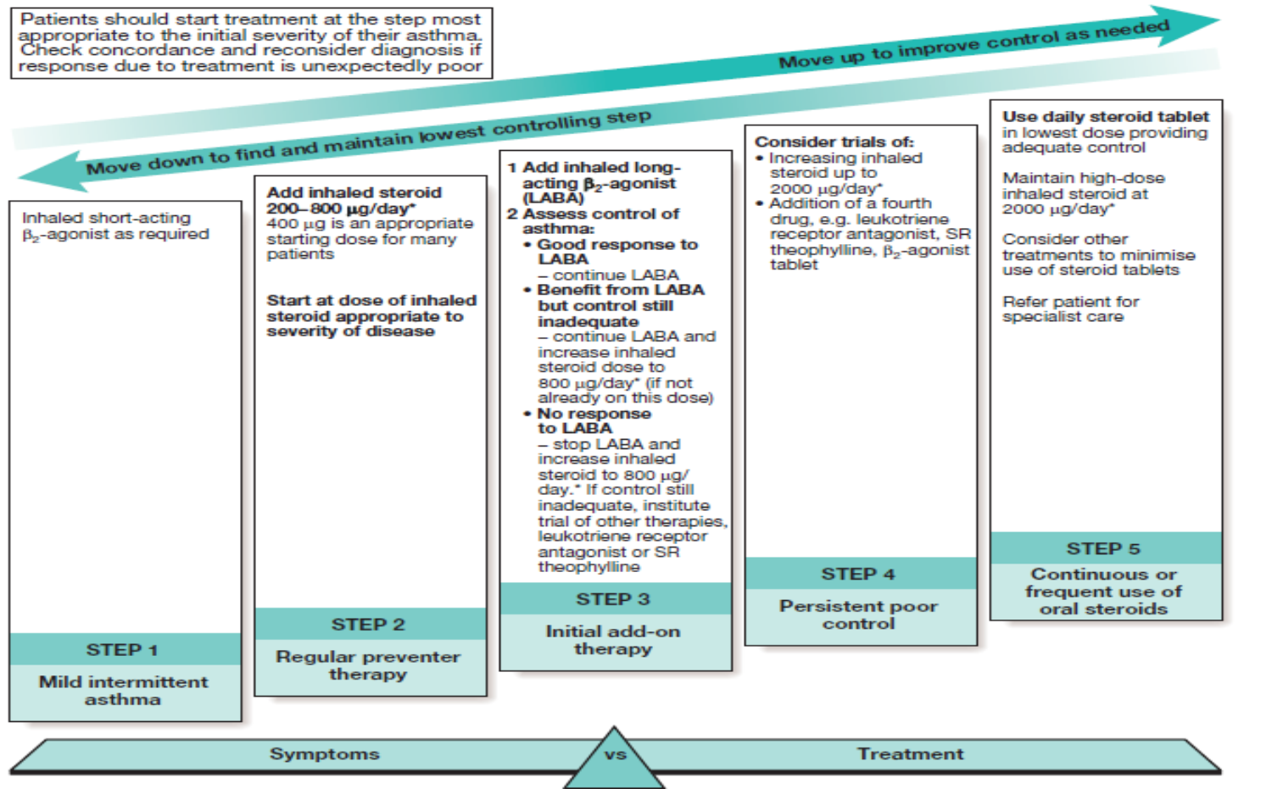
UNIVERSITY OF BASRAH AL-ZAHRAA MEDICAL COLLEGE
Ministry of Higher Education and Scientific Researches
Management of Asthma
Avoid triggers LO6

Slide 35
UNIVERSITY OF BASRAH AL-ZAHRAA MEDICAL COLLEGE
Ministry of Higher Education and Scientific Researches
LO6

Slide 36
UNIVERSITY OF BASRAH AL-ZAHRAA MEDICAL COLLEGE
Ministry of Higher Education and Scientific Researches
Acute attacks of asthma:
Nebulised B2 agonists and ipratropium delivered in oxygen.
Intravenous steroids
Short course of high dose oral prednisolone
Other drugs: magnesium sulphate and aminophylline.
May require ventilation.
LO7

Slide 37
UNIVERSITY OF BASRAH AL-ZAHRAA MEDICAL COLLEGE
Ministry of Higher Education and Scientific Researches
COPD:
LO8
Smoking cessation
Patient education
Pneumococcal vaccination
Monitoring of weight, nutrition status, and physical activity.
Bronchodilators
Inhaled corticosteroid
Pulmonary rehabilitation
Long term oxygen treatment
Acute exacerbation of COPD:
Monitoring for hypoxia and hypercapnia
Antibiotics
Nebulised bronchodilators
Oral steroids
24% or 28% Oxygen
Non-invasive ventilation

Slide 38
UNIVERSITY OF BASRAH AL-ZAHRAA MEDICAL COLLEGE
Ministry of Higher Education and Scientific Researches

